Slide 1
WELCOME

Slide 2

BUS RESERVATION SYSTEM
(Online Bus Ticket Booking)

Slide 3
BHARTIYA JAIN SANGHATANAS ART,SCINCE & COMMERCE COLLEGE,WAGHOLI
Guided By:
Rubicon team
Presented By :
Akshay Barane
Tanuja Bendbhar
Parag Paraskar
Jayesh Nagargoje
Tejaswi Pawar

Slide 4
DEVELOPERS
Akshay Barane
Tanuja Bendbhar
Parag Paraskar
Jayesh Nagargoje
Tejaswi Pawar

Slide 5
ABSTRACT
The main aim of the project was to develop a website which would facilitiate the reservation of online bus ticket through an effective and yet simple for a normal passenger intending to travel in buses. Apart from reserving tickets, through our system a passenger can booking online tickets ‘from’ various cities ‘to’ various cities.

Slide 6
Functional Requirement
Bus company name
Bus contact number
Bus address
Departure
Destination
Date and Day
Passenger name
No of Passenger
Seat no
Bus type ( AC/NON AC)
Boarding point address
Total Fare
Departure time

Slide 7
MUDULES
Admin Registration : This system can create passenger username and password.
Admin Login : the system can book online tickets of passenger , where they want to go.

Slide 8
MUDULES
Passenger Registration : The system stores all the necessary information of the passengers.
Show Ticket : This shows the seat you have booked and from which destinations you are traveling.

Slide 9
Used Software & Language
Visual Studio Code
PYTHON

Slide 10
ER DIAGRAM
.
Bname
fare
To
Max seats
Bid
From
has
Type
BUS
Route
Depart
Date
Time
AC/NON AC
Ticket no
Reserves
Pid
passenger
Pname
password

Slide 11
USE CASE DIAGRAM
Use case diagram consists of use cases and actors and shows the interaction between them. The key points are:
The main purpose is to show the interaction between the use cases and the actor.
To represent the system requirement from user's perspective.
The use cases are the functions that are to be performed in the module.
An actor could be the end-user of the system or an external system

Slide 12
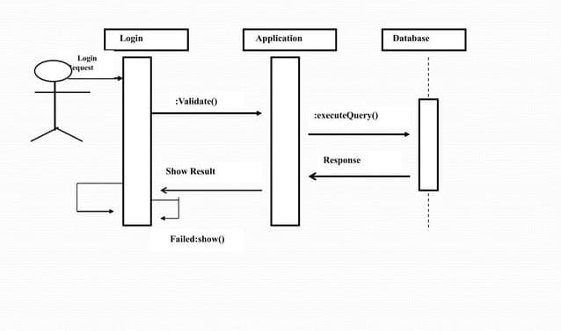
SEQUENCE DIAGRAM
.

Slide 13
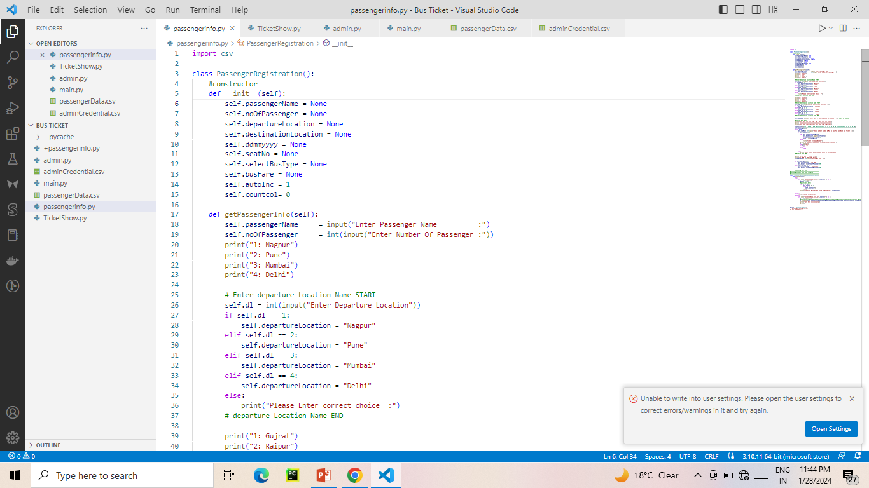

Slide 14
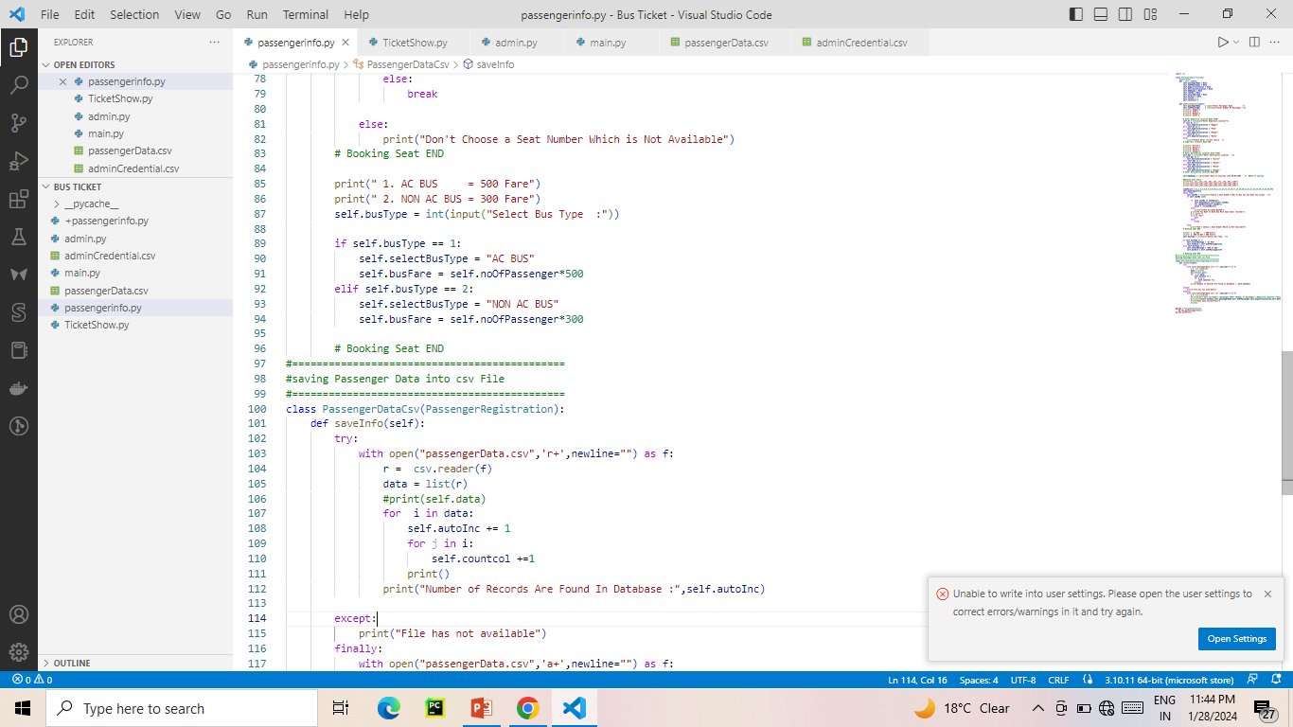

Slide 15
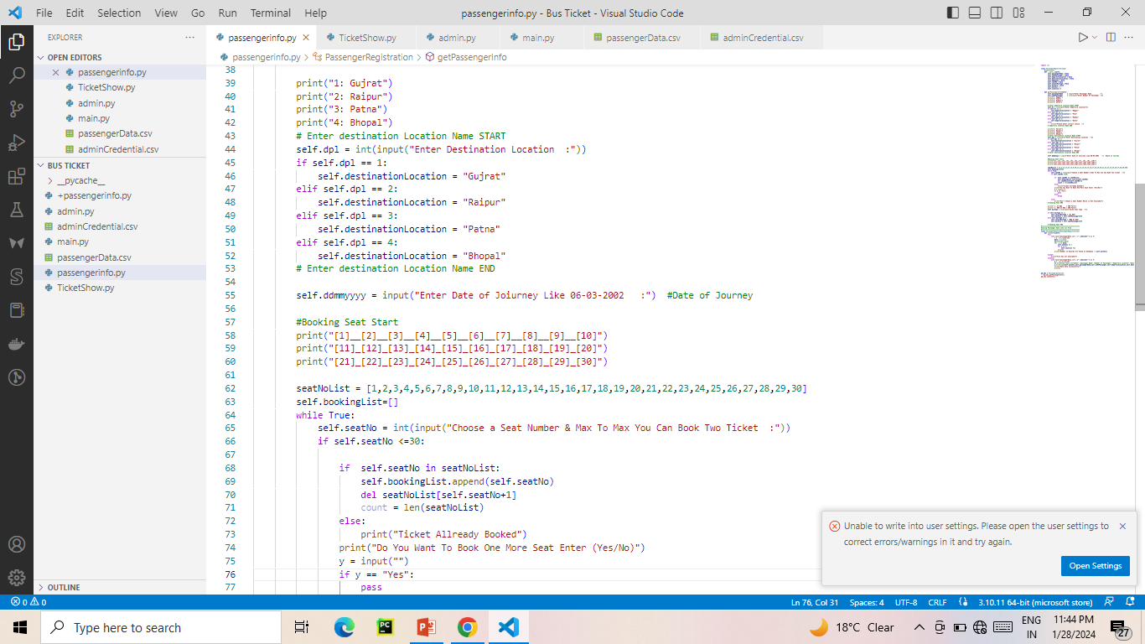

Slide 16
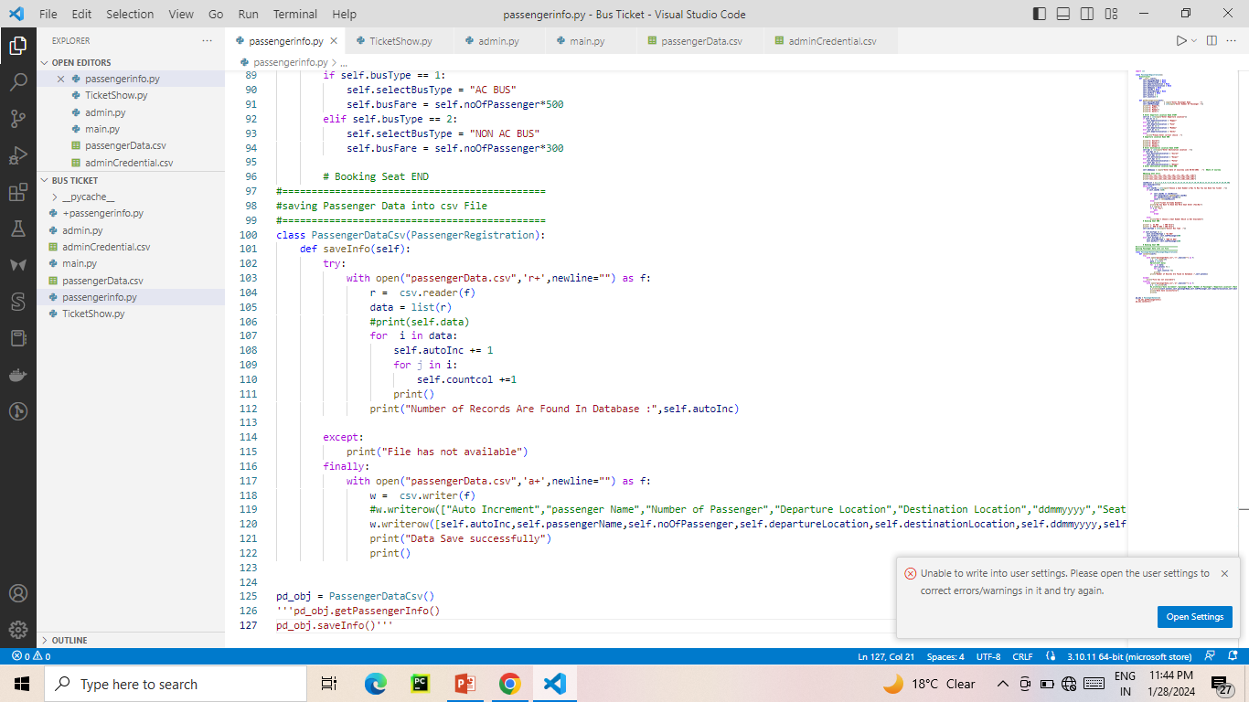

Slide 17
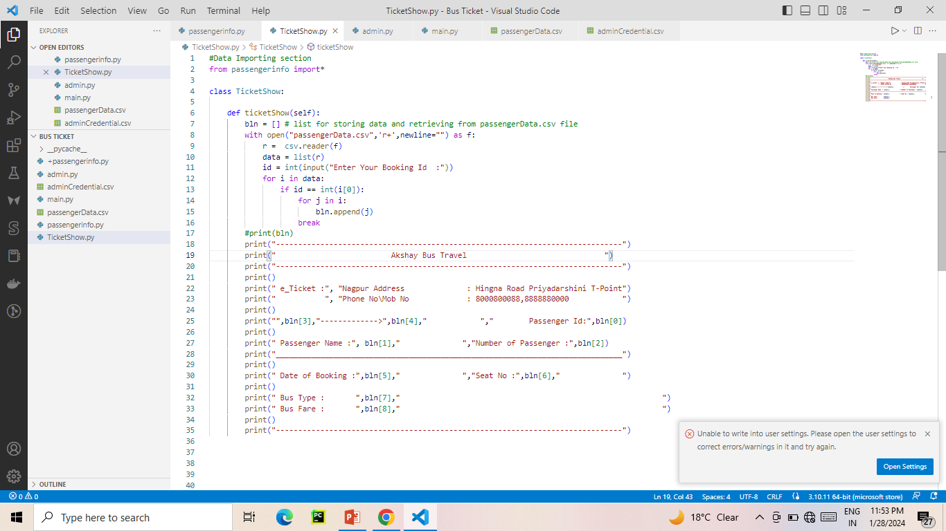

Slide 18
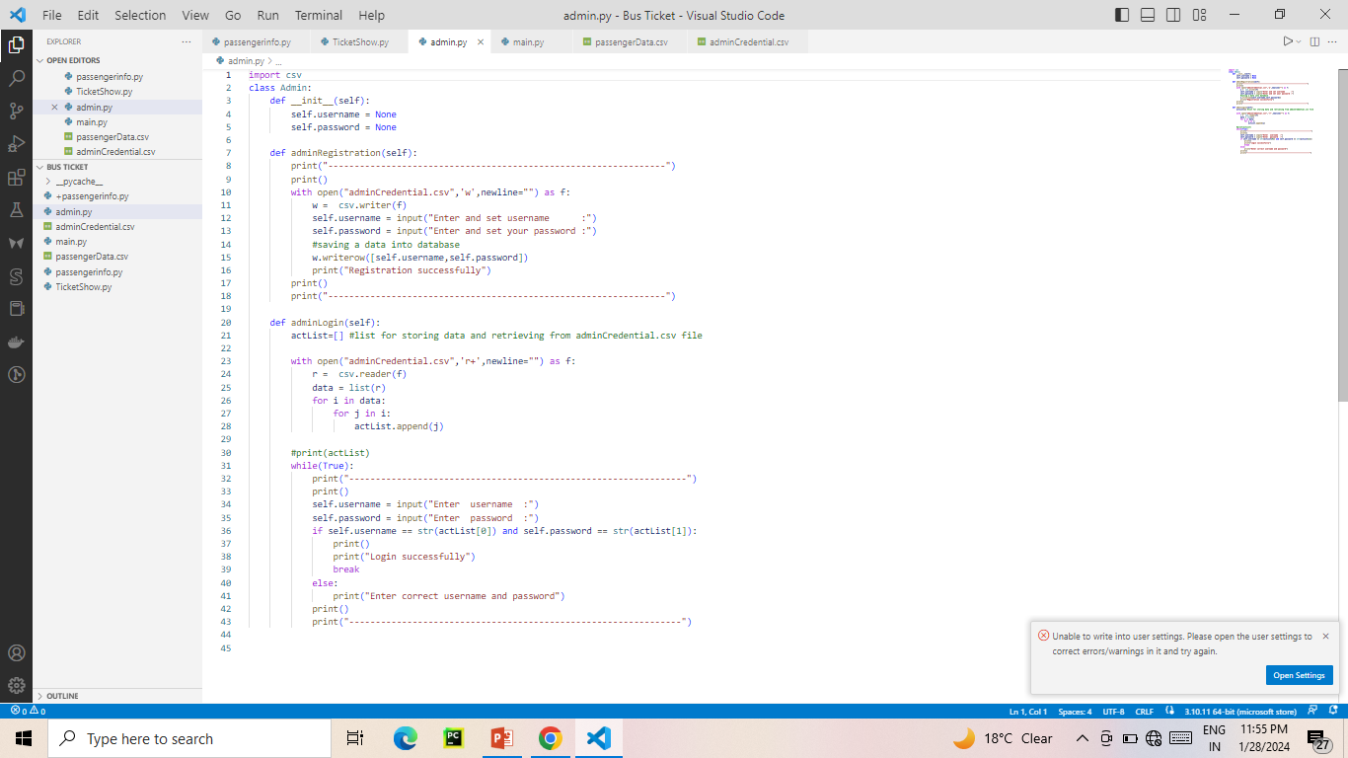

Slide 19
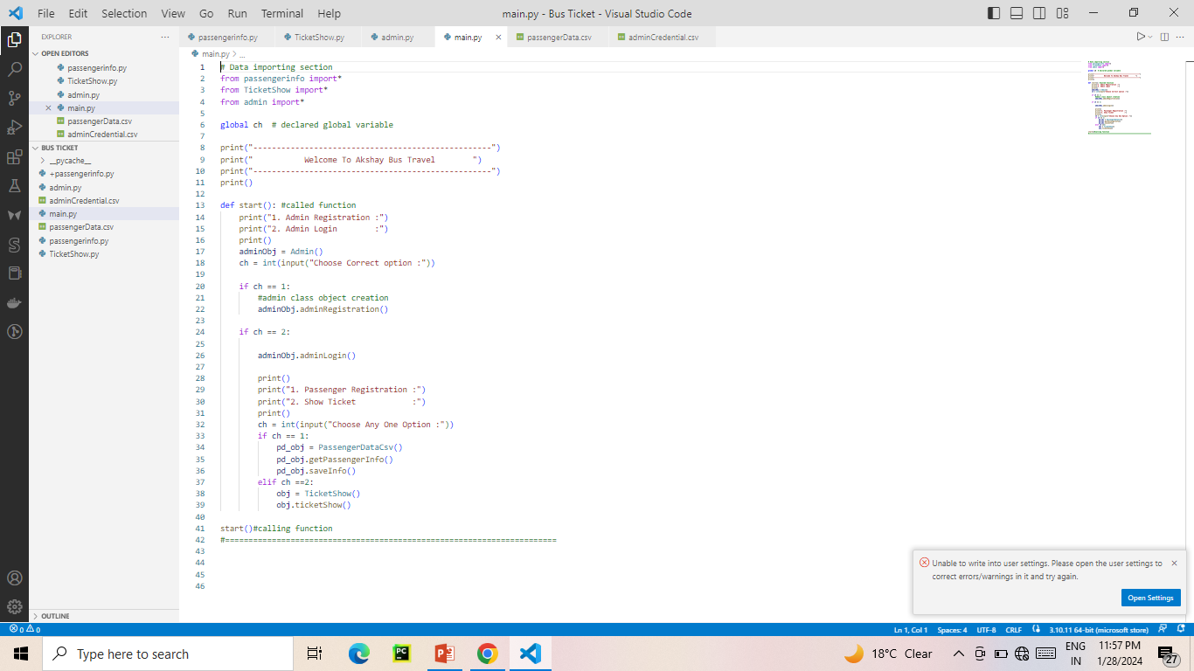

Slide 20
BIBLIOGRAPHY
FOR VISUAL STUDIO INSTALLATION
https://code.visualstudio.com
FOR PYTHON
www.w3school.com

Slide 21
THANKYOU

